Slide 1

easeP21
An R tool to ease the Pinnacle 21 review process
Team members: Longfei LI, Xing WANG, Enki WANG, Nana XI
on behalf of CoE – SDR, Sanofi

Slide 2

The views and opinions expressed in this presentation are those of authors and do not necessarily reflect the official views and policies of Sanofi or position of China Pharma RUG 2025.

Slide 3

Content
01
Background
02
Mechanisms and Principles
03
Tool Intro: Functions & Shiny

Slide 4
Background

Slide 5
Background – P21
Accelerate the Drug Administration Approval Process
Pinnacle 21 is the key to a rapid and efficient drug review process for the biopharmaceutical industry. It is the technology driving the FDA 21st Century Review Program, ensuring that submitted data is compliant, useful, and ready for review—leading to a more efficient review process.
Website
Pinnacle 21

Slide 6

Background – P21
P21 for DBL
data issue
Final check
FPI : 1st P21
mapping issue
MD structure issue
P21 per milestone
data issue
MD structure issue
Programming issue
P21 for submission
data issue
MD issue
CT issue
Explanation/solution
Study start-up
Study conduct
Study close-out
Submission
Database design
CRF design
FTS set-up
Data entry
System convention
Mapping
Programming
EDL loading
CRF page in/active
Programming
MD completement
CT development
Programming
Programming issue
Data issue
Mapping issue

Slide 7
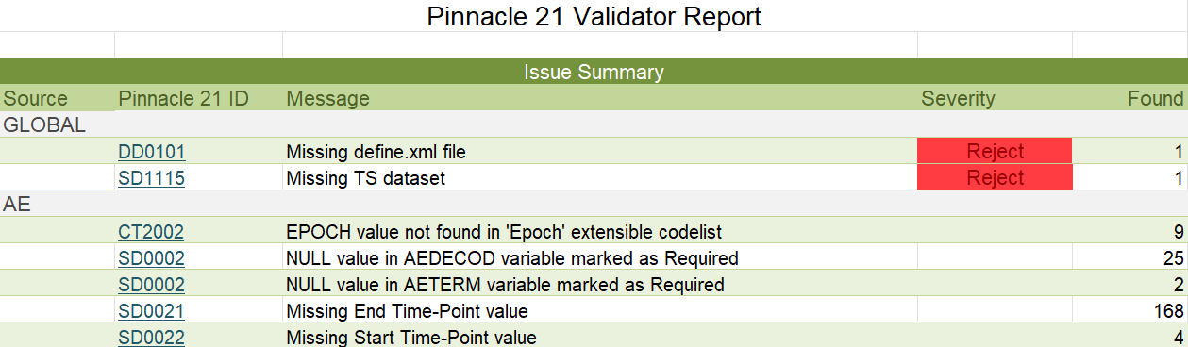
Background – P21
Shortcoming and Challenge
Only for SDTM
1. The classification of issues is not clear, and the responsible personnel are not identified
P21 only presents the information and number of issues within each domain dataset without the ability to specifically categorize them into whether they are data issues, mapping issues, programming issues, or false issues caused by ongoing processes.

Slide 8
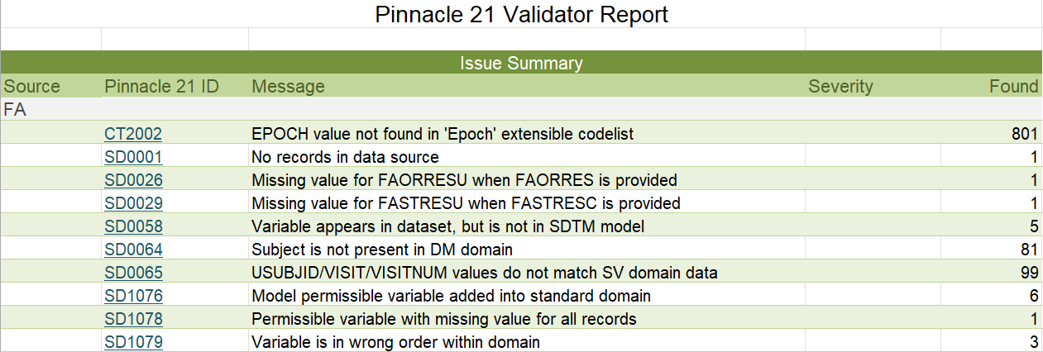
Background – P21
Shortcoming and Challenge
Only for SDTM
2. Issues related to the split domain cannot be clearly identified as belonging to which dataset
P21 aggregates all issues and displays them within the split domain without specifying the exact dataset, resulting in the inability to directly verify the issues within the respective datasets.

Slide 9
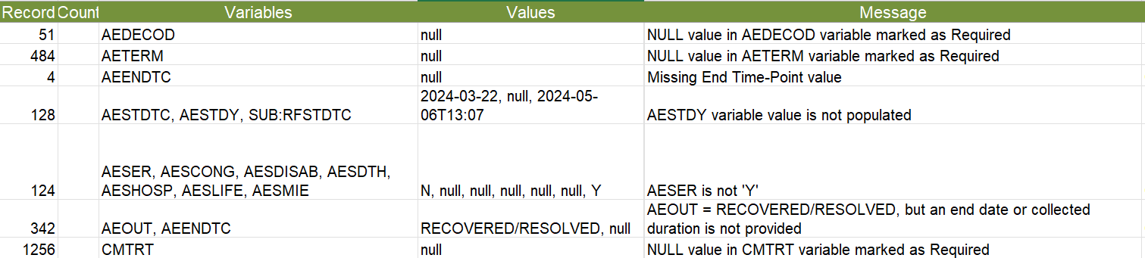
Background – P21
Shortcoming and Challenge
Only for SDTM
3. SDTM-related data information about issue is incomplete
P21 only provides the variable values that were found to have issues during the check, as well as the position (record) of the observation in the SDTM data. It does not offer an identifier, or other variable information that can accurately trace back to the raw data, leading to an excessively long time spent on issue checking.

Slide 10
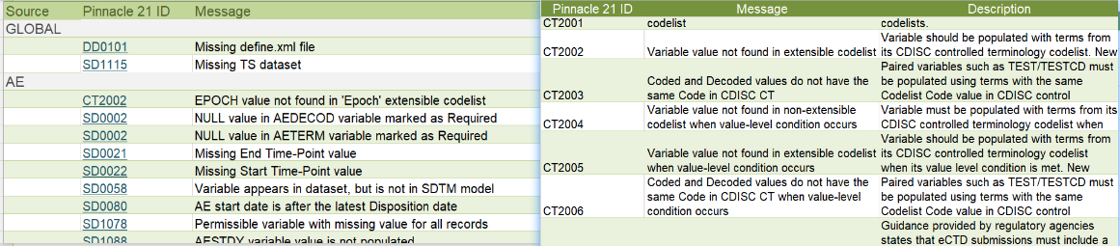
Background – P21
Shortcoming and Challenge
SDTM and ADaM
4. Reviewing is cumbersome, and synchronization across multiple sheets
P21 displays issues and rules in separate sheets. If you need to understand the specific P21 rule corresponding to an issue, you need to switch from the issue sheet to the rule sheet to view it.

Slide 11
Background – P21
Shortcoming and Challenge
SDTM and ADaM
5. Unable to retain the comments made during previous issue verification checks
P21 only performs checks on the current SDTM/ADaM dataset and outputs the corresponding report. Explanations for the same issues that appeared previously cannot be retained, resulting in a significant amount of repetitive work.

Slide 12
Background – R
R Shiny UI
An outstanding UI framework for human-computer interaction
Powerful tools for code-free operations
All in R
Besides SAS, R is currently the most widely used language in Sanofi BP
Build a complete set of data tools using R

Slide 13
Mechanism and Principles

Slide 14
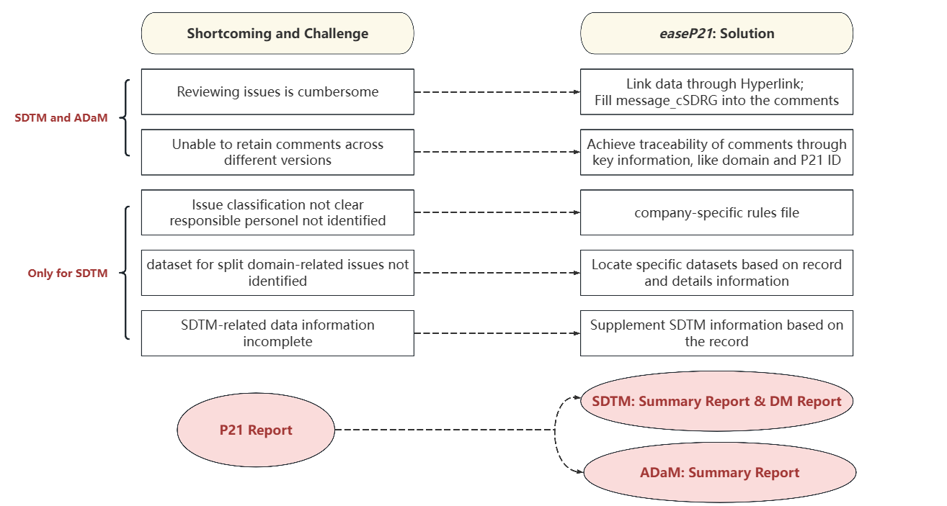
easeP21: Summary
Concept and Solution
rules-based automatic processing

Slide 15
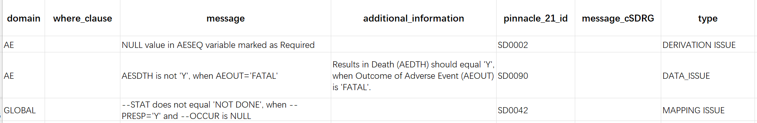
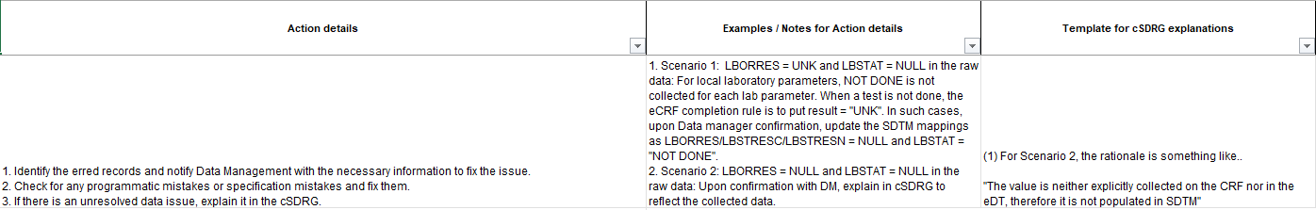
easeP21: Key technical points
1. Classification of issues, and identification of responsible personnel
Company-specific rules file
Identity issues category: data issues, mapping issue, derivation issues, ongoing study
Provide fix tips: action plan , data reviewer guide explanation example

Slide 16
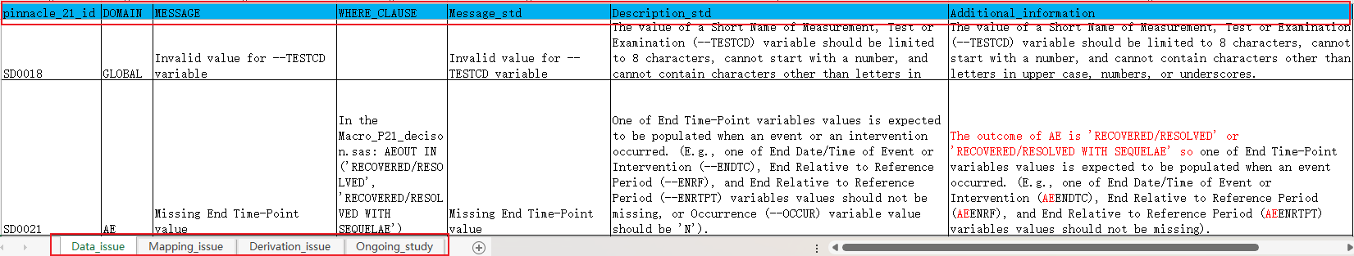
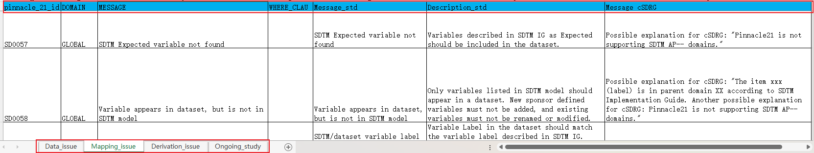
easeP21: Key technical points
1. Classification of issues, and identification of responsible personnel
Sanofi: P21_Decision_Version_Engine_version.xlsx
One sheet represents one issue category
If a P21 issue can correspond to multiple categories, it should be distinguished based on the where clause.
Considering pinnacle_21_id, domain, message, and where clause comprehensively, make a judgment on the issue category.

Slide 17
easeP21: Key technical points
1. Classification of issues, and identification of responsible personnel
Where Clause
P21_id | Domain | message | Where clause | Issue type
SD0021 | AE | Missing End Time-Point value | AEOUT IN ('RECOVERED/RESOLVED', 'RECOVERED/RESOLVED WITH SEQUELAE') | Data issue
 |  |  | AEOUT NOT IN ('RECOVERED/RESOLVED', 'RECOVERED/RESOLVED WITH SEQUELAE') | Ongoing study
SD0080 | AE | AE start date is after the latest Disposition date | USUBJID IN (USUBJID in DS where DSDECOD="LAST CONTACT") | Data issue
 |  |  | USUBJID NOT IN (USUBJID in DS where DSDECOD="LAST CONTACT") | Ongoing study
SD0082 | EX | EX END date is after the latest Disposition date | USUBJID IN (USUBJID in DS where DSDECOD="LAST CONTACT") | Data issue
 |  |  | USUBJID NOT IN (USUBJID in DS where DSDECOD="LAST CONTACT") | Ongoing study

Slide 18
easeP21: Key technical points
1. Classification of issues, and identification of responsible personnel
Categorize each finding according to these 4 types of issues
Specify the responsible personnel
ROLE | Type of issue | Responsible personnel
DATA ISSUE | Data | Data Manager
MAPPING ISSUE | Structure | Programmer
DERIVATION ISSUE | Derivation | Programmer
ONGOING STUDY* | Due to ongoing study | Waiting for Subject end of study
* If there is an ongoing study issue when DBL, it is considered a data issue.

Slide 19
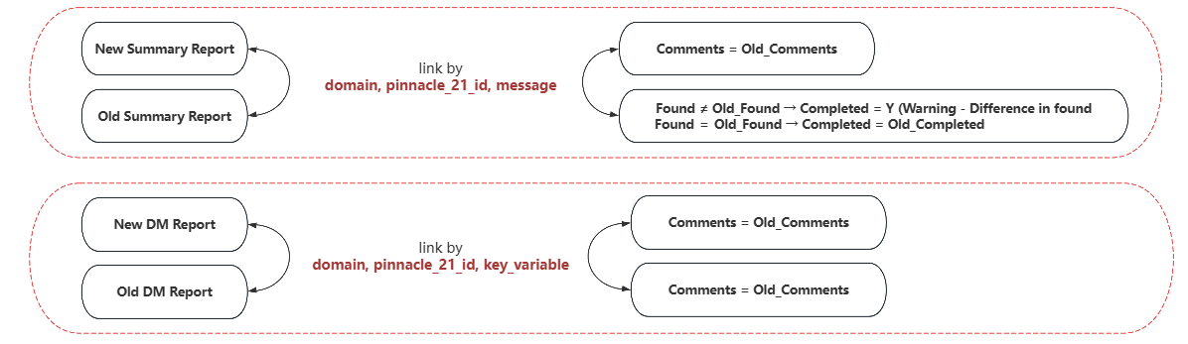
easeP21: Key technical points
2. Retain comments across different versions
Achieve traceability of comments through key information, like domain and P21 ID

Slide 20
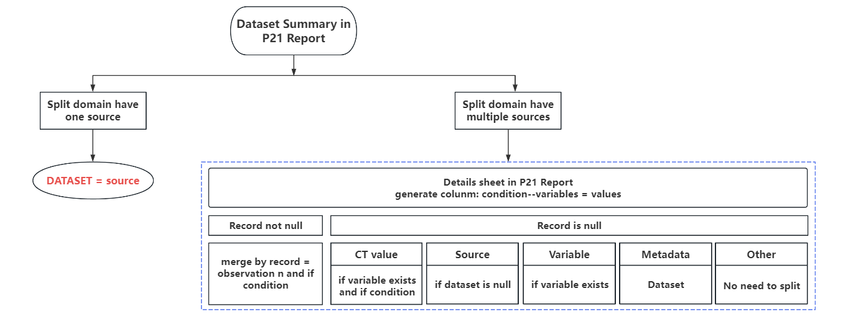
easeP21: Key technical points
3. Split domain-related issues process
Locate specific datasets based on record and details information

Slide 21
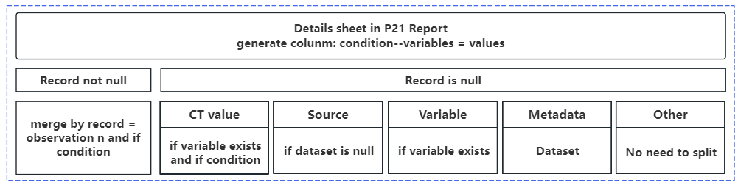
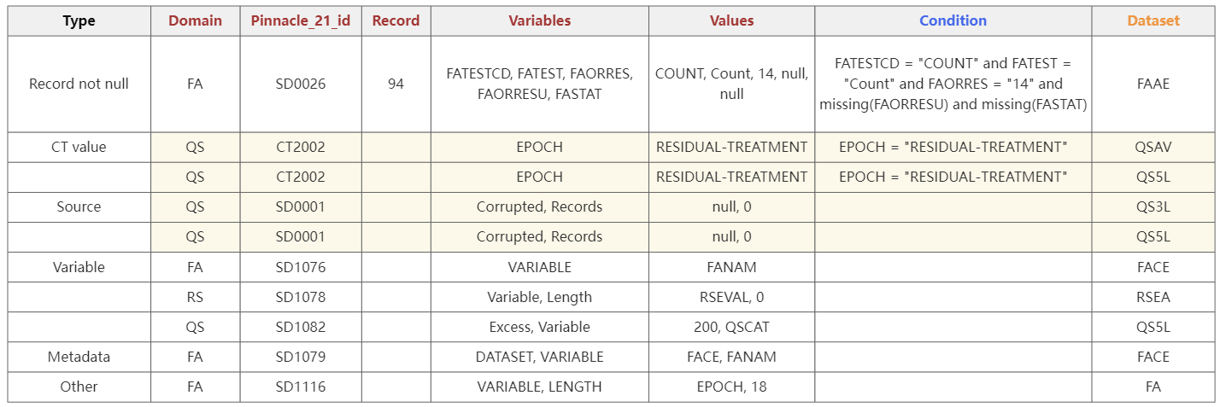
easeP21: Key technical points
3. Split domain-related issues process
Locate specific datasets based on record and details information
Red variables indicate the variables that exist in the original details sheet; blue variables represent temporary variables generated when running the macro, and orange variables indicate the final output variables.
Rows with a yellow background indicate that one row in the details may correspond to multiple split datasets.
SD1116: Inconsistent variable length within split datasets

Slide 22
Tool Intro

Slide 23
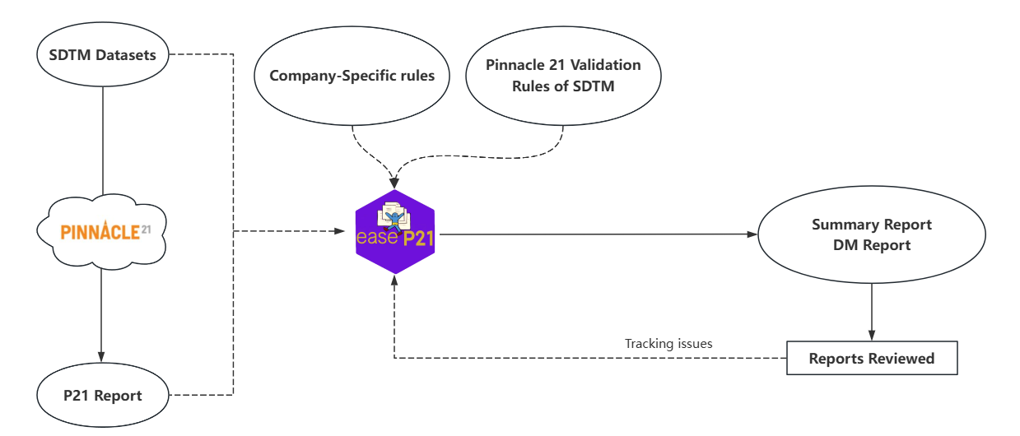
easeP21: Process
Process — SDTM

Slide 24
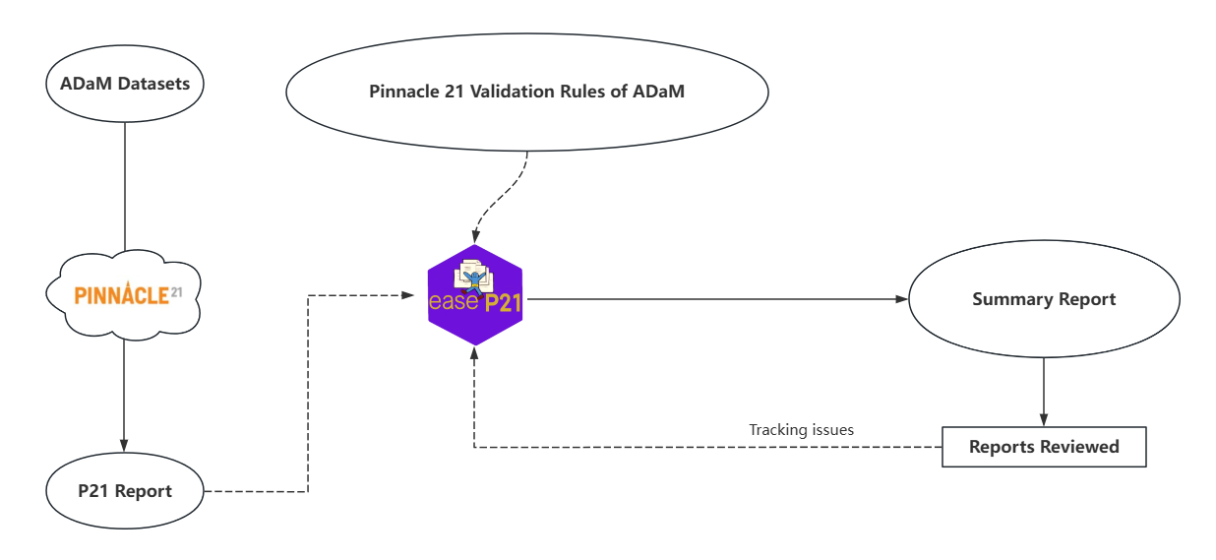
easeP21: Process
Process — ADaM

Slide 25
easeP21: Package
Main functions Diagram: rules-based automatic processing
INPUT
PROCESS
OUTPUT
c
c
P21 Report:
Latest & Previous
1-read_p21_report
4-P21_dataset_list
5-Ease_P21:
P21_summart_report
p21_dm_report
Output Summary report:
  Fix tips for Statistical programmer
Output DM report:
  Data issues for data manager
SDTM Datasets:
xpt form
2-read_xpt_files
Rules file:
Company specific rules & P21 rules
3-read_p21_rule_action/read_p21_rule_decision
Ouptput Link data:
  Details directly link to data
6-P21_link_data

Slide 26
easeP21: Package
Functions details
Functions | Describe
Read sources files
read_p21_report | Read Pinnacle 21 Validator Report Excel File
read_xpt_files | Read XPT files from a specified directory
read_p21_rule_action | Read Pinnacle 21 Validation Rules Action Plan Excel File
read_p21_rule_decision | Read Pinnacle 21 Validation Rules Decision Excel File
Integrate and Process
p21_dataset_list | Integrate P21 report and XPT data
p21_summary_report | Summary report contains the explanation example and action plan
p21_dm_report | Data issues report for data management and track the data issues status
p21_link_data | Link the P21 report and XPT data
ease_P21 | Wrap functions and generate P21 DM and Summary Reports at once

Slide 27
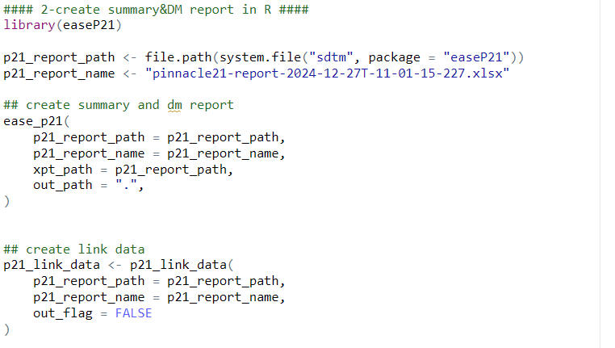
easeP21: Package
Call Functions
**data under ‘sdtm` folder from [SDTM Metadata Submission Guidelines v2.0] (https://www.cdisc.org/standards/foundational/sdtm/sdtm-metadata-submission-guidelines-v2-0）

Slide 28
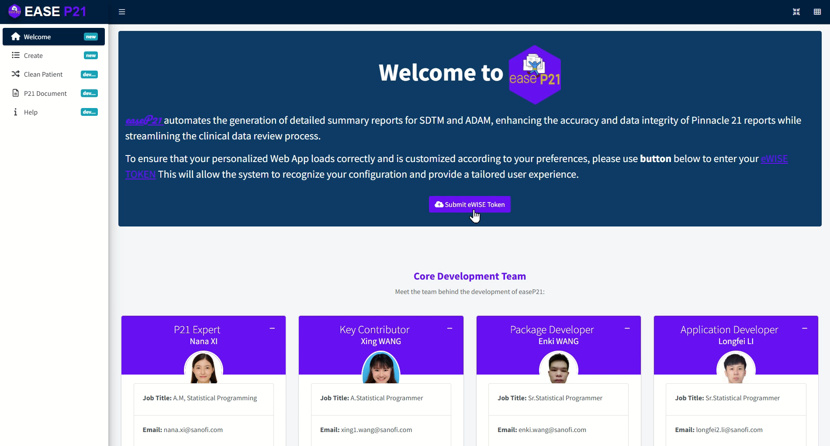
easeP21: Shiny

Slide 29
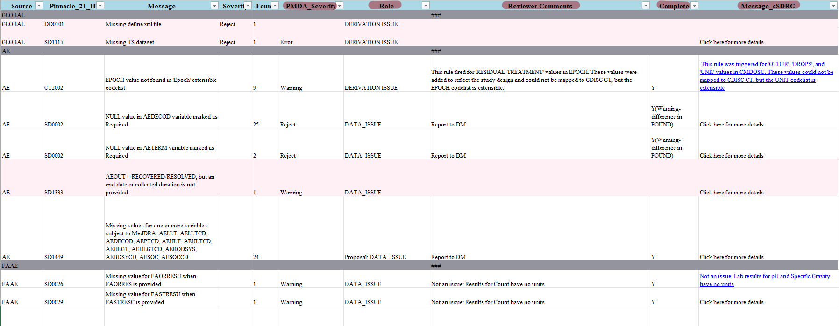
easeP21: Output
Output — Summary Report

Slide 30
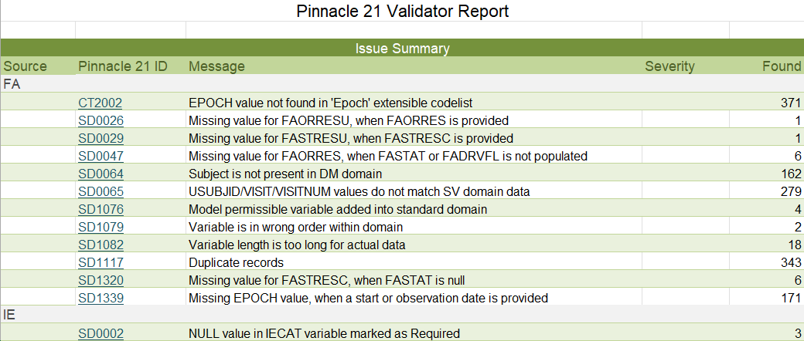
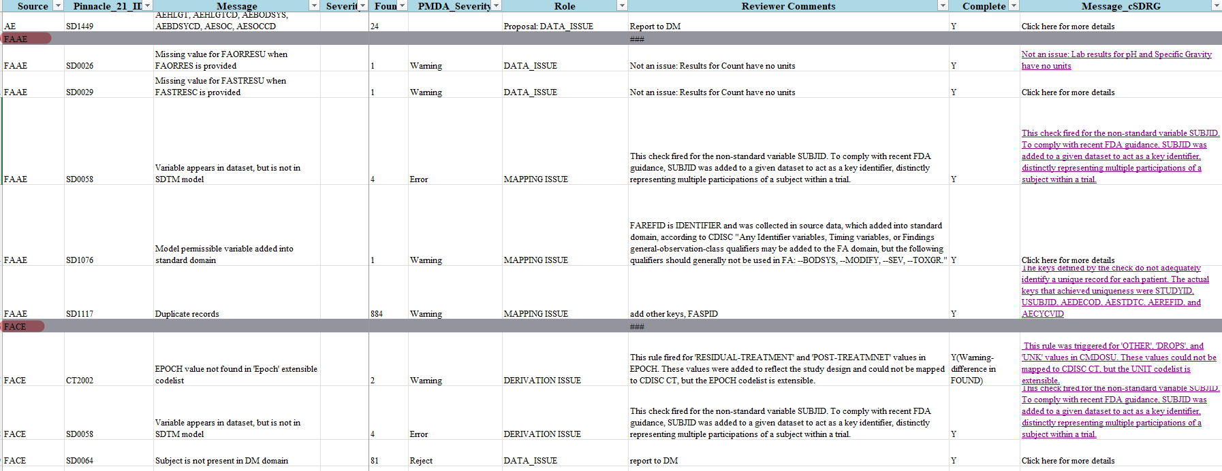
easeP21: Output
Output — Summary Report

Slide 31
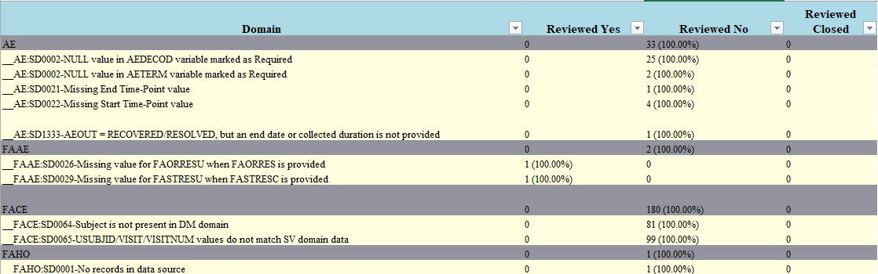
easeP21: Output
Output — DM Report
Review status summary
Completeness status

Slide 32
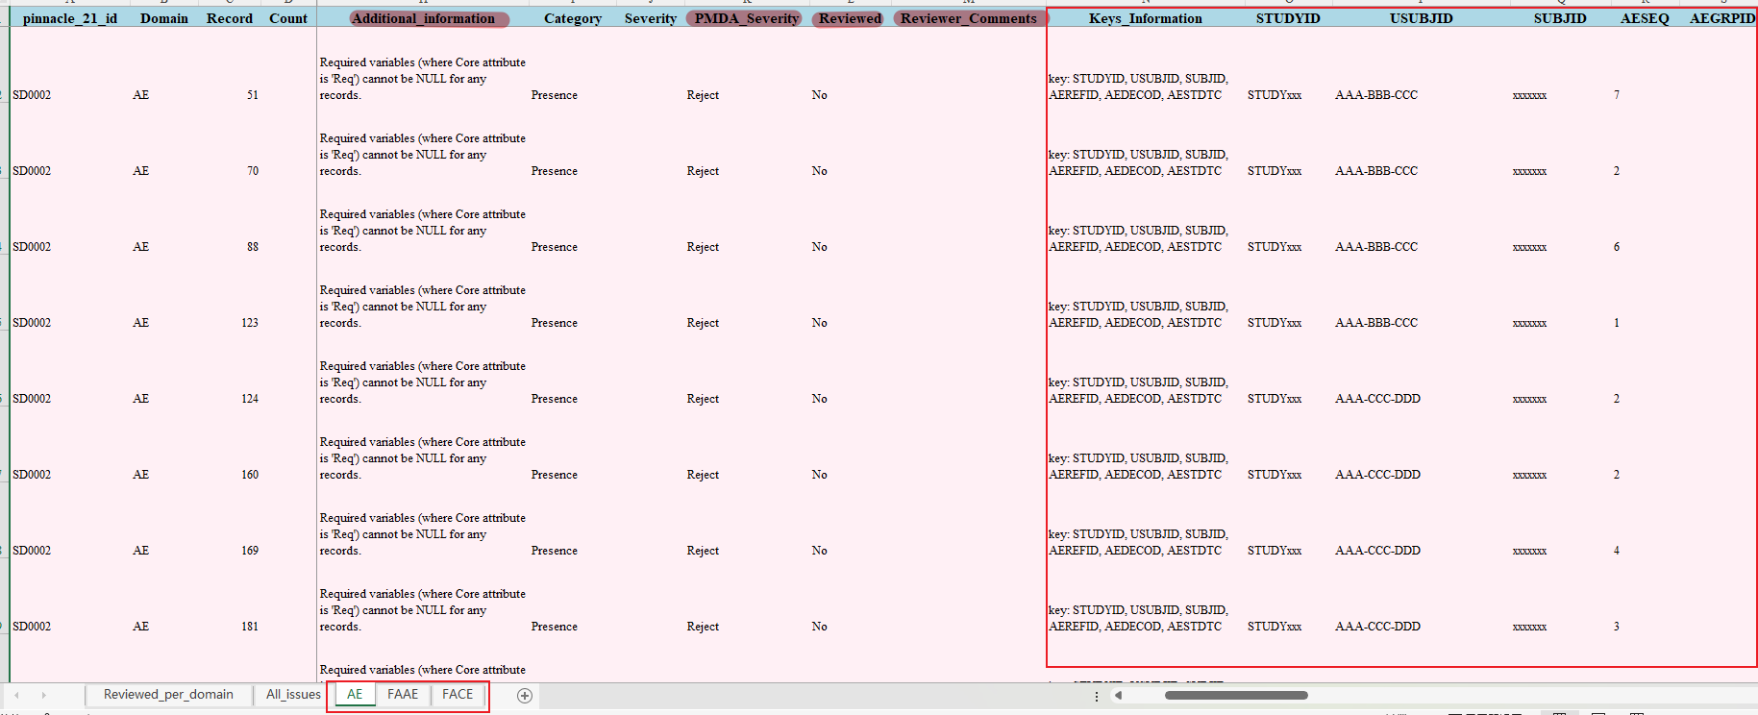
easeP21: Output
Output — DM Report

Slide 33
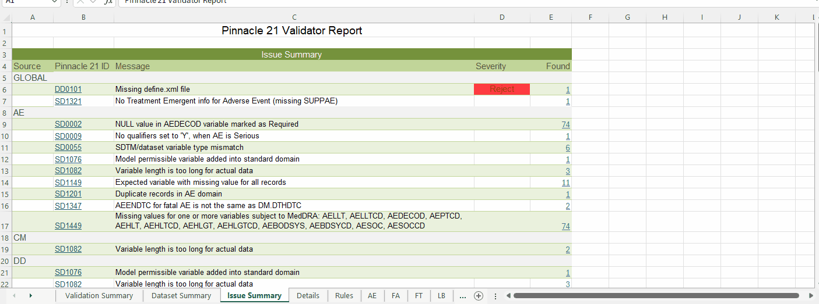
easeP21: Output
Output — Link data

Slide 34
easeP21: Challenge
Reduce runtime for large data
Background R process and automatically check by callr::r_bg() and later::later()
  Users can proceed immediately without waiting for this long task to finish √
Parallel processing package future and furrr √
High-performance package data.table or duckdb

Slide 35
easeP21: Advantages
    An easier way to understand the issues and to identify actions
    Adequate sharing of issues between stakeholders
Users’ feedback
    Help departments divide responsibilities and work together
    A better reviewable template to facilitate traceability and inspection
      At least 50% gain of time

Slide 36
Thanks
Thank you to the authors and organizers of Pharma Rug, and to all the authors of R open-source packages. Thanks to the Sanofi and CoE-SDR team members for their various forms of assistance.

